Slide 1
Chapter Three
Analyzing the Marketing Environment

Slide 2
Analyzing the Marketing Environment
Topic Outline
The Company’s Microenvironment
The Company’s Macroenvironemnt
Responding to the Marketing Environment

Slide 3
The Marketing Environment
The marketing environment includes the actors and forces outside marketing that affect marketing management’s ability to build and maintain successful relationships with customers

Slide 4
The Marketing Environment
Microenvironment consists of the actors close to the company that affect its ability to serve its customers, the company, suppliers, marketing intermediaries, customer markets, competitors, and publics

Slide 5
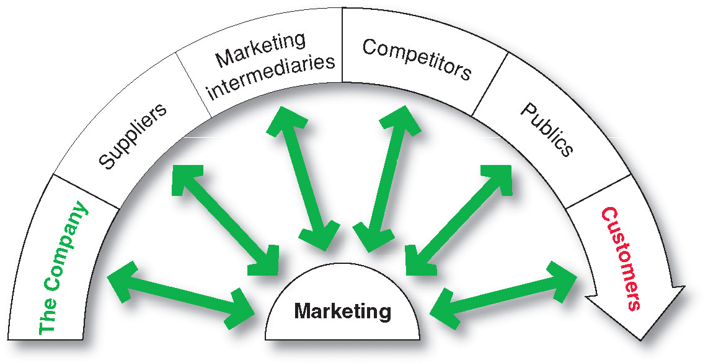
The Company’s Microenvironment
Actors in the Microenvironment

Slide 6
The Company’s Microenvironment
The Company
Top management
Finance
R&D
Purchasing
Operations
Accounting
Notes:
Note to Instructor
Discussion Questions
What types of collaboration does there need to be between the departments?
How might projects be integrated between marketing and finance?
How might projects be integrated between marketing and information systems?
This question on finance could lead to a discussion about budgeting for marketing. The collaboration between marketing and IS could lead to discussions of market research, ordering systems, and customer relationship management systems.

Slide 7
The Company’s Microenvironment
Suppliers
Provide the resources to produce goods and services
Treated as partners to provide customer value

Slide 8
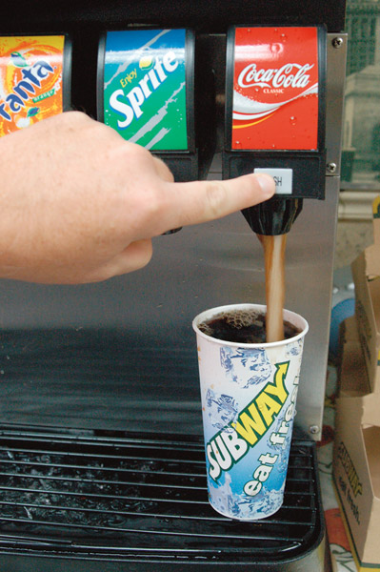
The Company’s Microenvironment
Marketing Intermediaries
Help the company to promote, sell and distribute its
products to final buyers
Notes:
Note to Instructor
The text explains how Coke delivers value for their marketing intermediaries:
They understand each retailer partner’s business
The conduct consumer research and share with partners
They develop marketing programs and merchandising for partners

Slide 9
The Company’s Microenvironment
Types of Marketing Intermediaries
Resellers
Physical distribution firms
Marketing services agencies
Financial intermediaries

Slide 10
The Company’s Microenvironment
Competitors
Firms must gain strategic advantage by positioning their offerings against competitors’ offerings
Notes:
Note to Instructor
Students should note that the competition is just a click away with online purchasing. This link goes to Bizrate—one of many comparison shopping sites online. Enter a product like coffee makers to see the competing products and retailers for this category.

Slide 11
The Company’s Microenvironment
Publics
Any group that has an actual or potential interest in or impact on an organization’s ability to achieve its objectives
Financial publics
Media publics
Government publics
Citizen-action publics
Local publics
General public
Internal publics
Notes:
Note to Instructor
In slideshow view, click on movie icon to launch Tom’s Shoes video snippet. See accompanying DVD for full video segment.

Slide 12
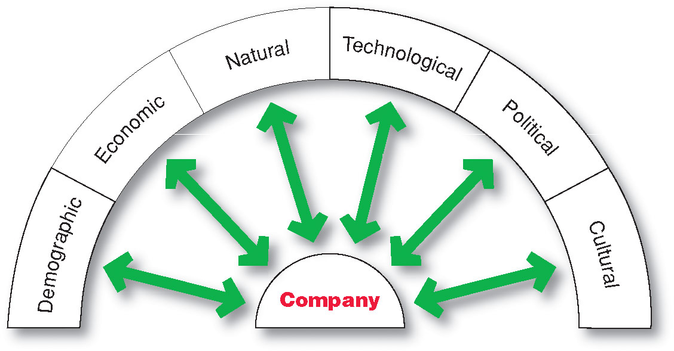
The Company’s Macroenvironment

Slide 13
The Company’s Macroenvironment
Demographic Environment
Demography is the study of human populations in terms of size, density, location, age, gender, race, occupation, and other statistics
Demographic environment is important because it involves people, and people make up markets
Demographic trends include age, family structure, geographic population shifts, educational characteristics, and population diversity

Slide 14
The Company’s Macroenvironment
Demographic Environment
Changing age structure of the population
Baby boomers include people born between 1946 and 1964
Most affluent Americans
Notes:
Note to Instructor
There are many Web sites targeted to boomers including this link to Boomers International. Before following the link it might be interesting to ask the following:
Discussion Questions
What type of information boomers might be seeking?

Slide 15
The Company’s Macroenvironment
Demographic Environment
Generation X includes people born between 1965 and 1976
High parental divorce rates
Cautious economic outlook
Less materialistic
Family comes first
Lag behind on retirement savings

Slide 16
The Company’s Macroenvironment
Demographic Environment
Millennials (gen Y or echo boomers) include those born between 1977 and 2000
Comfortable with technology
Includes
Tweens (ages 8–12)
Teens (13–19)
Young adults (20’s)

Slide 17
The Company’s Macroenvironment
Demographic Environment
Generational marketing is important in segmenting people by lifestyle of life state instead of age

Slide 18
The Company’s Macroenvironment
Demographic Environment
More people are:
Divorcing or separating
Choosing not to marry
Choosing to marry later
Marrying without intending to have children
Increased number of working women
Stay-at-home dads

Slide 19
The Company’s Macroenvironment
Demographic Environment
Growth in U.S. West and South and decline in Midwest and Northeast
Moving from rural to metropolitan areas
Changes in where people work
Telecommuting
Home office
Divorcing or separating

Slide 20
The Company’s Macroenvironment
Demographic Environment
Changes in the Workforce
More educated
More white collar
Notes:
Note to Instructor
Students are probably very familiar with job search sites such as this link to monster.com. It might be interesting to compare the listings for white collar versus blue collar job opportunities including the associated pay and benefits.

Slide 21
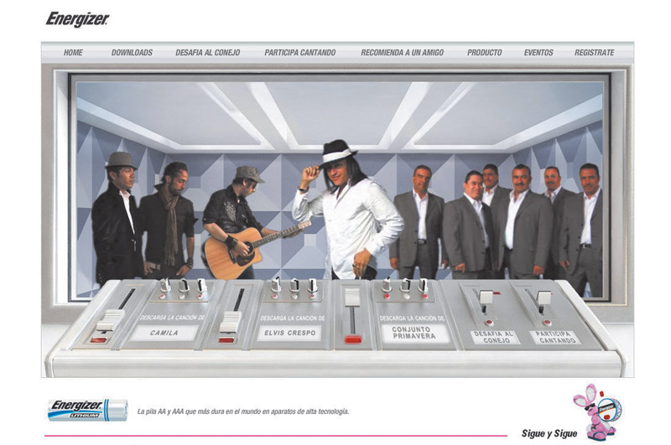
The Company’s Macroenvironment
Demographic Environment
Increased Diversity
Markets are becoming more diverse
International
National
Includes:
Ethnicity
Disabled

Slide 22
The Company’s Macroenvironment
Economic Environment
Economic environment consists of factors that affect consumer purchasing power and spending patterns
Industrial economies are richer markets
Subsistence economies consume most of their own agriculture and industrial output

Slide 23
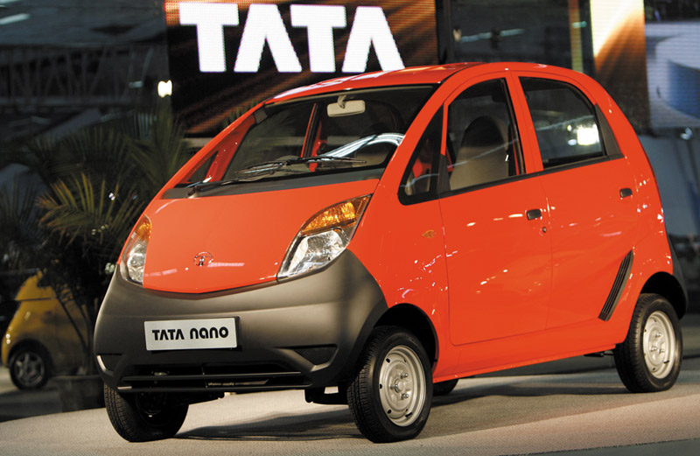
The Company’s Macroenvironment
Economic Environment
Changes in income
Value marketing involves ways to offer financially cautious buyers greater value—the right combination of quality and service at a fair price
Notes:
Note to Instructor
This graphic highlights a car targeted to India’s growing middle class.
Discussion Questions
What changes might there be in U.S. income over the next year? What are positioned as “value cars.”
The students might quote current economic declines or rises. The “value cars” will probably include some of the smaller cars by Kia, Ford, Honda, and Toyota.

Slide 24
The Company’s Macroenvironment
Economic Environment
Changes in Consumer Spending Patterns
Ernst Engel—Engel’s Law
As income rises:
The percentage spent on food declines
The percentage spent on housing remains constant
The percentage spent on savings increases

Slide 25
The Company’s Macroenvironment
Natural Environment
Natural environment involves the natural resources that are needed as inputs by marketers or that are affected by marketing activities
Trends
Shortages of raw materials
Increased pollution
Increase government intervention
Environmentally sustainable strategies
Notes:
Note to Instructor
This Web link connects to greenbiz.com. There are several Web sites like this that provide information on business as to how to practice green strategies including green marketing.

Slide 26
The Company’s Macroenvironment
Technological Environment
Most dramatic force in changing the marketplace
Creates new products and opportunities
Safety of new product always a concern
Notes:
Note to Instructor
Discussion Question
Ask students what changes they have seen in technology in the past four years including medical products, communications, and media.
They will most likely talk about the use of artificial organs and stem cell research, the growth of PDA’s like the iPod, and the use of new media products including DVR or TiVo.

Slide 27
The Company’s Macroenvironment
Political Environment
Political environment consists of laws, government agencies, and pressure groups that influence or limit various organizations and individuals in a given society

Slide 28
The Company’s Macroenvironment
Political Environment
Legislation regulating business
Increased legislation
Changing government agency enforcement
Increased emphasis on ethics
Socially responsible behavior
Cause-related marketing

Slide 29
The Company’s Macroenvironment
Cultural Environment
Cultural environment consists of institutions and other forces that affect a society’s basic values, perceptions, and behaviors

Slide 30
The Company’s Macroenvironment
Cultural Environment
Persistence of Cultural Values
Core beliefs and values are persistent and are passed on from parents to children and are reinforced by schools, churches, businesses, and government
Secondary beliefs and values are more open to change and include people’s views of themselves, others, organization, society, nature, and the universe

Slide 31
The Company’s Macroenvironment
Cultural Environment
Shifts in Secondary Cultural Values
People’s view of themselves
Yankelovich Monitor’s consumer segments:
Do-it-yourselfers—recent movers
Adventurers
People’s view of others
More “cocooning”
Notes:
Note to Instructor
Do-It-Yourselfers—Recent Movers:
Active consumers also view the experience as a form of self-expression.
They view their homes as their havens
View their projects as personal victories over the high-priced marketplace.
Adventurers:
Rarely follow a single path or do the same thing twice.
View the experience as far more exciting than the entertainment value.
They are more likely to engage in activities most think are too dangerous.

Slide 32
The Company’s Macroenvironment
Cultural Environment
Shifts in Secondary Cultural Values
People’s view of organizations
People’s view of society
Patriots defend it
Reformers want to change it
Malcontents want to leave it

Slide 33
The Company’s Macroenvironment
Cultural Environment
Shifts in Secondary Cultural Values
People’s view of nature
Some feel ruled by it
Some feel in harmony with it
Some seek to master it
People’s view of the universe
Renewed interest in spirituality

Slide 34
Responding to the Marketing Environment
Views on Responding
Uncontrollable
React and adapt to forces in the environment
Proactive
Aggressive actions to affect forces in the environment
Reactive
Watching and reacting to forces in the environment

